Slide 1
Rigor Mortis?
No!
Notes:
Emily

Slide 2
Just
RIGOR!
Notes:
Emily

Slide 3
Objectives for today:
To identify the characteristics of rigor
To apply those characteristics to classroom instruction
To propose strategies and techniques for adding rigor in the classroom
Notes:
Debbie

Slide 4
Rigor in the classroom is...
Rigor in the classroom is NOT...
In a rigorous classroom , students are...
Notes:
Nikki - Padlet responses

Slide 5
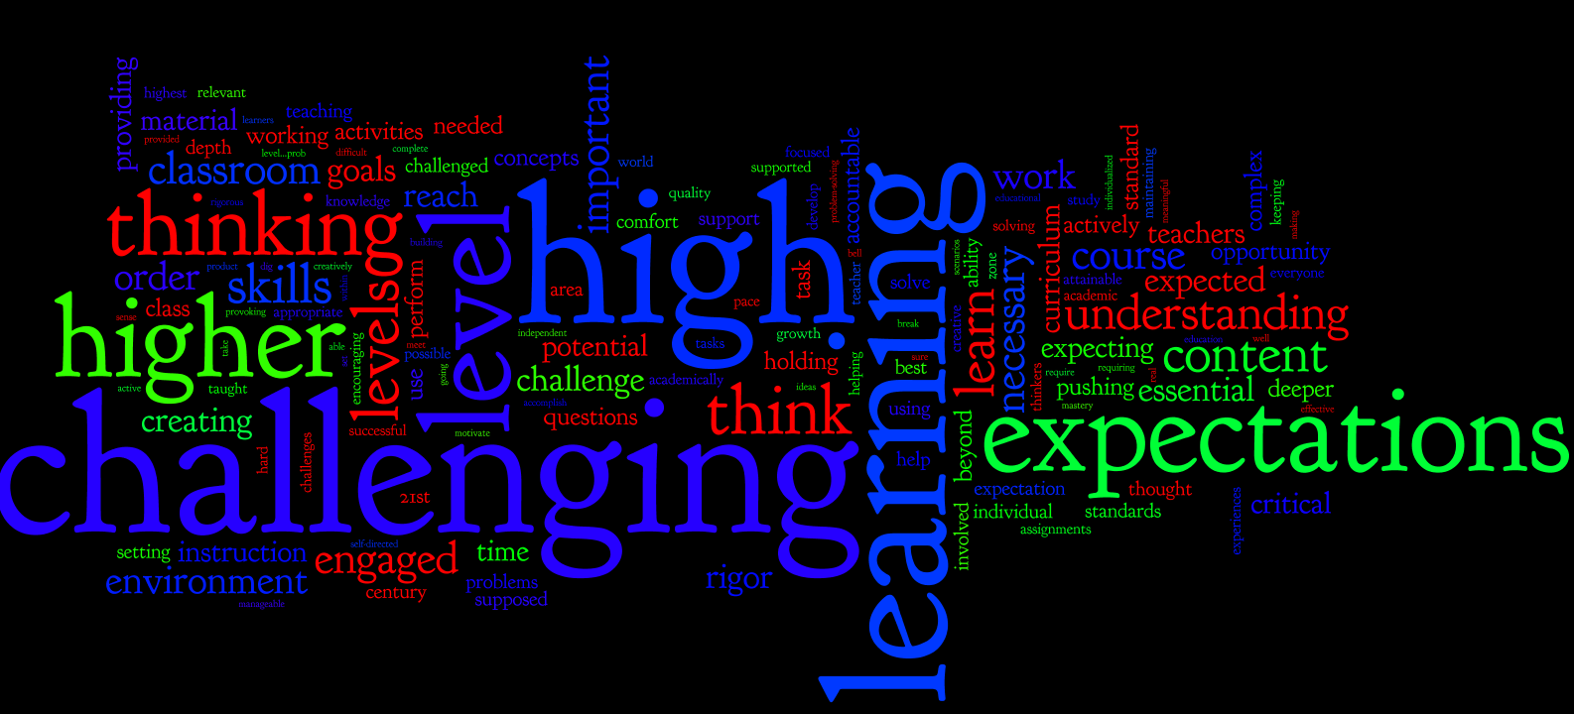
Rigor is….
Notes:
Nikki:”a goal educators should strive for.” “being challenging within the range of perceived abilities of the students.” “Essential; based on quality NOT quantity; attainable at all levels” “key to a good education” “essential to progress, and must be understood by students and parents as something that is expected.”

Slide 6
Rigor is not….
Notes:
Nikki: “always easy to achieve”, “giving grades based on participation”, “covering the material” “increased workload” “not a joke”

Slide 7
In a rigorous classroom, students are…..
“sweating” “Enjoying class and learning.”
“challenged and maybe inspired”
“active, happy, and learning....not repeating answers to a test.”
“leading their learning and making their own discoveries, which are then shared with other students in the classroom”
Notes:
Nikki add wordle

Slide 8
“True rigor is creating an environment in which each student is expected to learn at high levels, each student is supported so he or she can learn at high levels, and each student demonstrates learning at high levels”. (Blackburn).
Notes:
Emily

Slide 9
Twist your pipe cleaner into a shape that illustrates how your students will respond when you increase the rigor in your classroom.
Notes:
Emily

Slide 10
Share with a partner how your creation illustrates your students’ responses to increased rigor.
Notes:
Emily - Have 3-5 pairs share their creations and explanations.

Slide 11
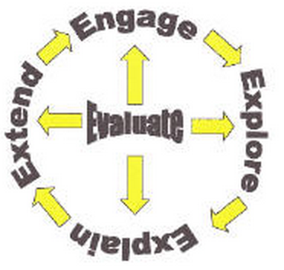
5E Learning Cycle
Engage
Explore
Explain
Extend
Evaluate
Notes:
Emily - Explain the 5E Learning Cycle is a teaching format that will provide a basis to increase rigor. Relate the 5E cycle to the pipe cleaner activity.

Slide 12
Verb Activity
STRATEGIES TO INCREASE RIGOR
Notes:
Debbie lead matching verbs into 6 categories of Bloom’s Taxonomy Power Verbs

Slide 13
249 Bloom’s Taxonomy Power Verbs
Type in http://tinyurl.com/bloomsverb
Notes:
Emily, Nikki, Caroline, Debbie, Christy AND Mrs.Lowman will monitor the six areas to provide feedback about correct placement of verbs. As student knowledge of content increases, so should your level of questioning. Debbie will wrap up this activity.

Slide 14
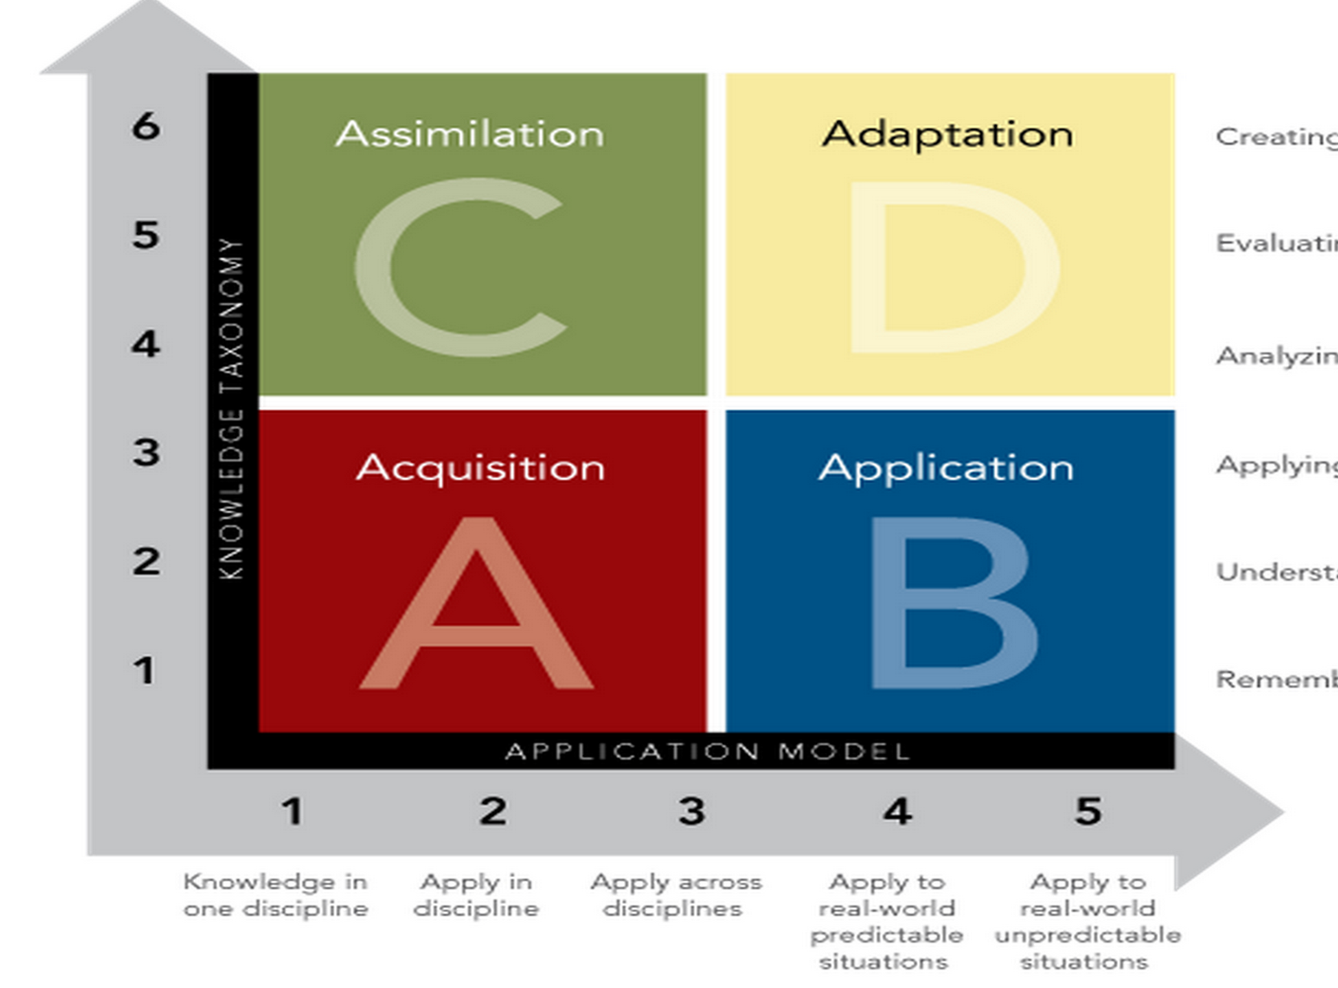
Creating
Evaluating
Analyzing
Applying
Understanding
Remembering
Notes:
A--Students gather and store bits of knowledge and information. Students are primarily expected to remember or understand this knowledge.
B--Students use acquired knowledge to solve problems, design solutions, and complete work. The highest level of application is to apply knowledge to new and unpredicted situations.
C-students extend and refine thier acquired knowledge to be able to use that knowledge automatically and routinely to analyze and solve problems and create solutions.
D-students have to competence to think in complex ways
A and C are the “rigor” piece and A and B are the “relevance”
Christy will help

Slide 15
In which quadrant of the matrix would this question/task fit?
Discover characteristics of a society in an
earlier decade by reading historical
documents such as wills and letters.
Find and measure the sides and angles
of a right triangle using the Pythagorean
Theorem and trigonometric ratios.
Notes:
Caroline’s slides 14-18 This fits into A

Slide 16
In which quadrant of the matrix
would this task/question fit?
Analyze your favorite commercial for fact and opinion.
Research and produce a news program on earthquakes.
Use physical, topographical, political, and
economic maps to compare and contrast
early American civilizations.
Notes:
This fits into C

Slide 17
In which quadrant of the matrix
would this task/question fit?
Obtain historical data about local weather
to estimate amounts of snow, rain, or sun
during a given season of the current year.
Create a Bill of Rights for your school or classroom.
Develop a concept for a new product, and
research the process for patenting the design.
Notes:
This is in D

Slide 18
In which quadrant of the matrix
would this task/question fit?
Conduct a meeting using parliamentary procedure.
Calculate percents of daily requirements met through a typical school lunch.
Notes:
This fits into Quadrant B

Slide 19
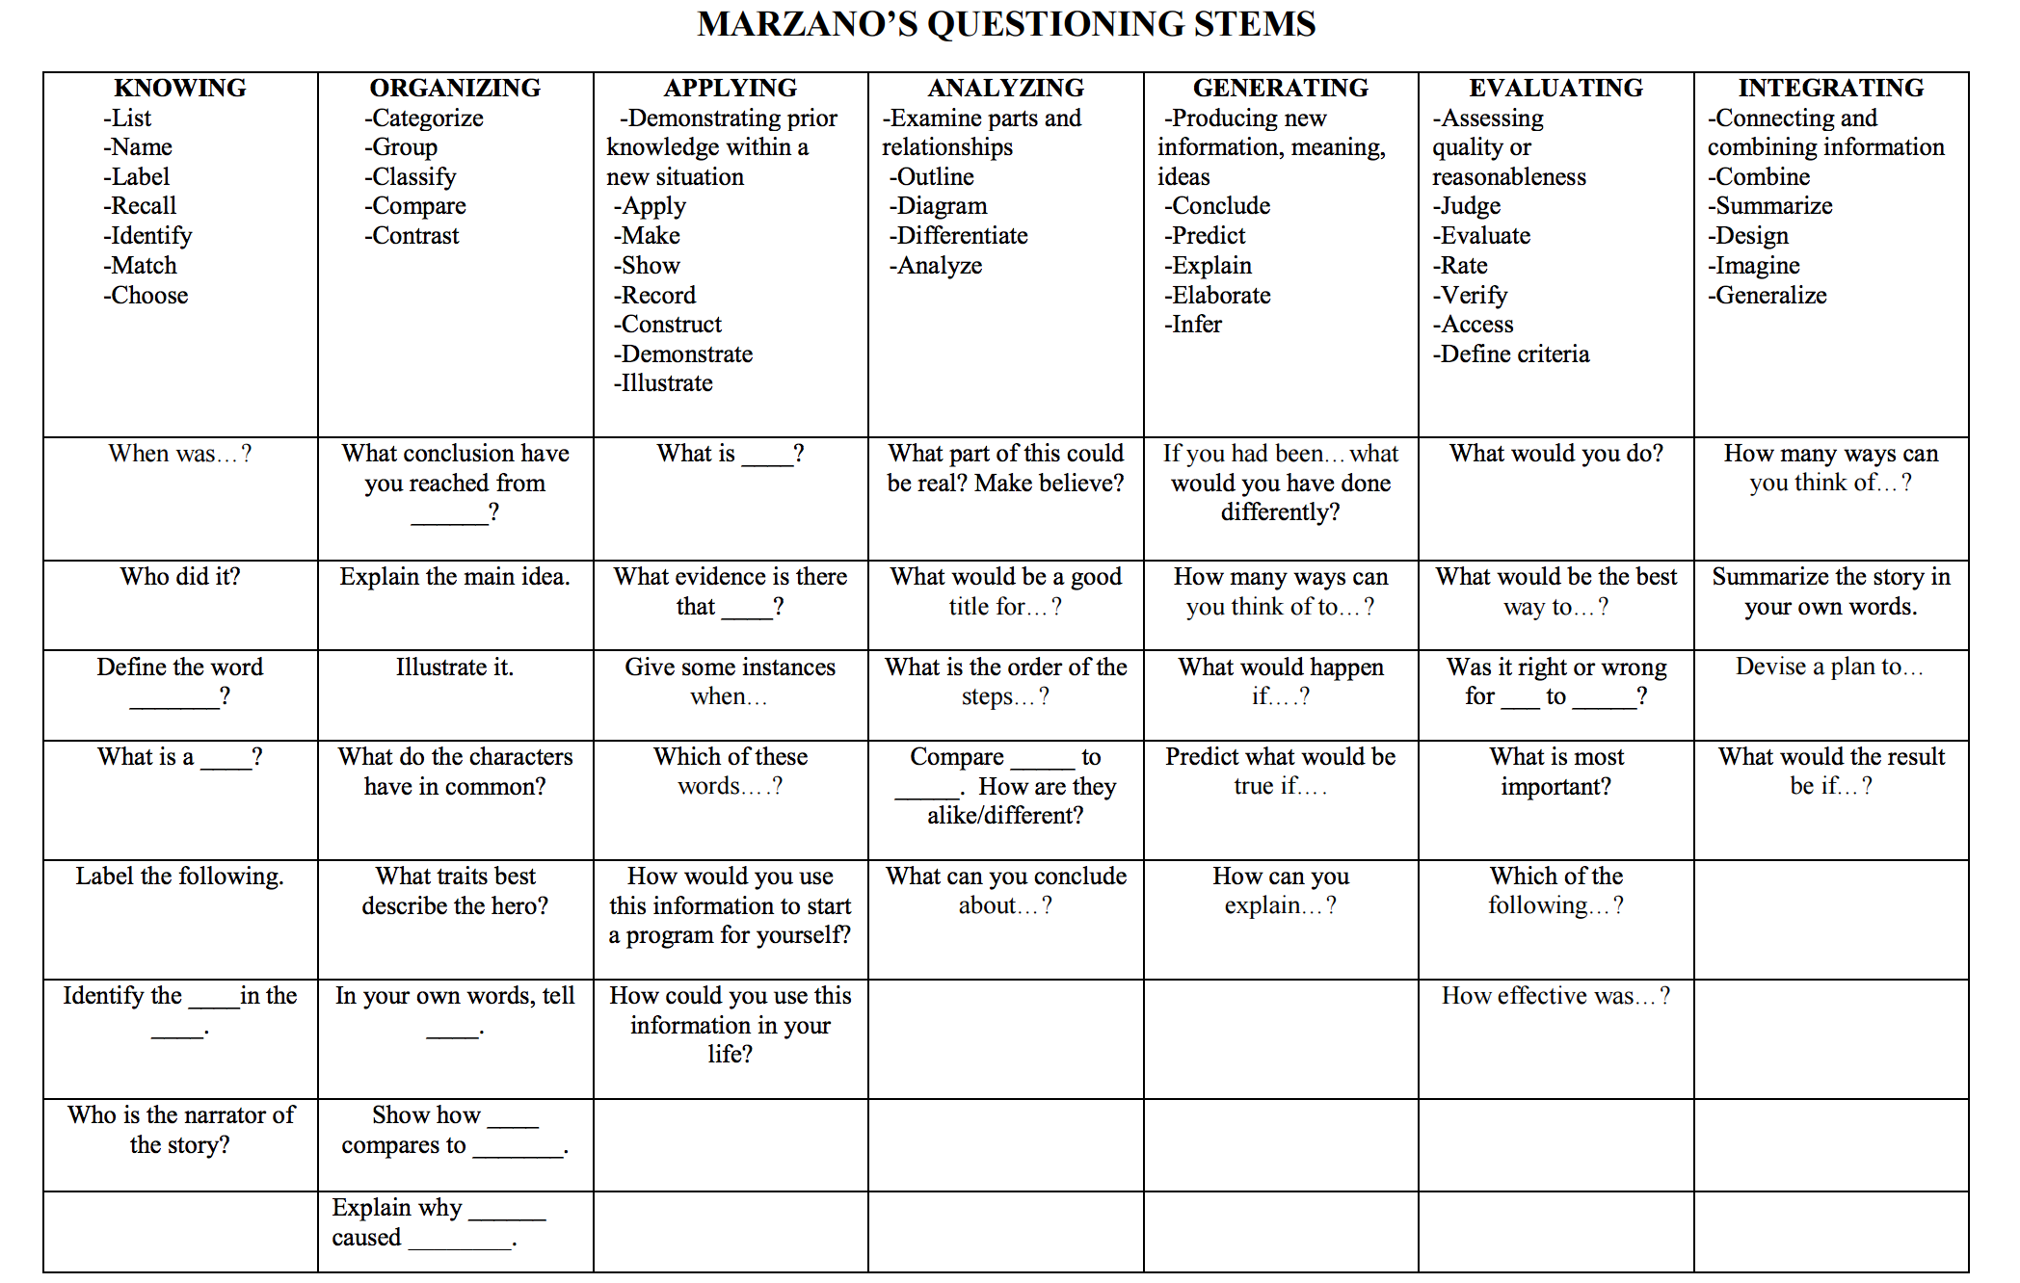
Notes:
Caroline - teacher examples to use in classroom lesson plans and test questions-

Slide 20
Now…..Let’s kick it up a notch!!!!!
Work in groups of four, and pick a topic.
Write a level A question.
Proceed to write a question for each quadrant of the matrix.
Be sure each question meets the application and knowledge requirements for that quadrant.
Notes:
Debbie - Explanation and completing - 10 minutes
Share - 5 minutes
Hand out papers for groups to record their questions.
Take up papers at the end.

Slide 21
Creating
Evaluating
Analyzing
Applying
Understanding
Remembering
Notes:
A--Students gather and store bits of knowledge and information. Students are primarily expected to remember or understand this knowledge.
B--Students use acquired knowledge to solve problems, design solutions, and complete work. The highest level of application is to apply knowledge to new and unpredicted situations.
C-students extend and refine thier acquired knowledge to be able to use that knowledge automatically and routinely to analyze and solve problems and create solutions.
D-students have to competence to think in complex ways
A and C are the “rigor” piece and A and B are the “relevance”
Christy will help

Slide 22
EXPECTATIONS
of what rigor looks like in the classroom…...
Notes:
Emily

Slide 23
Remember…………….There is NO SINGLE technique or strategy to increase the rigor of your instruction.
Notes:
Emily

Slide 24
Strategies
Differentiated Process
Think-pair share
Tiered tasks
Product based learning
Interactive reading guides
Investigations
Fan and Pick
Silent Conversations
Carousel Grafitti
Notes:
Christy

Slide 25
Strategies
Differentiated Product
Tic-tac-toe boards
Choice boards
Menus
Presentations
Project-Based Learning
Notes:
Christy

Slide 26
Strategies
Technology Tools
Kahoot
Socrative
Padlet
QR codes
Plickers
Join Me
Notes:
Nikki

Slide 27
Strategies
Communication
Socratic seminar
Classroom debates
Project presentations
Guest speakers
Carousel progression
Notes:
Debbie

Slide 28
Strategies
Vocabulary
Creating acrostics
Creating riddles
Creating analogies
Frayer models
Concept/Brain mapping
Notes:
Emily

Slide 29
Strategies
Differentiated Environment
Flexible learning spaces
Choices of learning (whole, cooperative groups, structured groups, tiered groups)
Single gender grouping
Notes:
Caroline

Slide 30
Try one of these...
http://www.gcasd.org/Downloads/Summarizing_Strategies.pdf
Notes:
Christy

Slide 31
Now What?
Notes:
Nikki

Slide 32
Purposeful lesson planning
Pre-class question development
Collaboration with PLCs
Development of common assessments
Notes:
Nikki

Slide 33
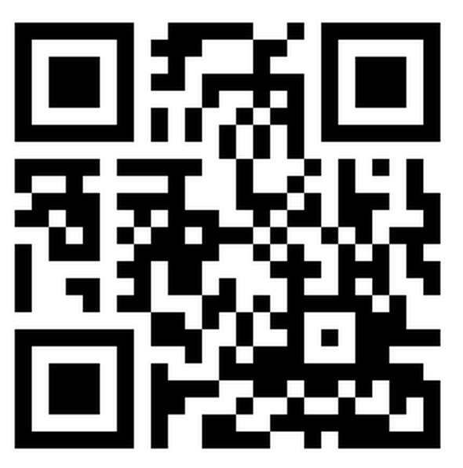
http://goo.gl/forms/0KrkaioQm4

Slide 34
Locations for Part II…….
Math - 601 Science - 602
SS - 604 ELA - 603
CTE - Auditorium
Reading Plus 10:30 - 12:30 - Media Center

